Slide 1
Cloud storage

Slide 2
Plan:
Introduction
Present the result
Risks of cloud storage
How to limit the risks
Discussion of result and Conclusion

Slide 3
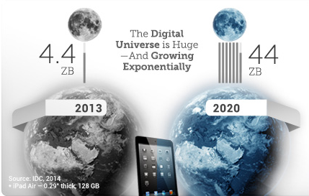
1. Introduction

Slide 4
Cloud Storage: 5 main attributes
Store data + computer power without human intervention
Access to data everywhere with internet connection
Shared Storage (friends / families)
Easy + user-friendly
No need for physical storage
Introduction

Slide 5
Aim & research questions
Aim :
Evaluate if the cloud storage technology is safe enough for users
Research Questions:
What are the possible danger of storing information with cloud storage technology?
What can the user do to limit risks?
Introduction

Slide 6
2. results

Slide 7

tRUST
Possible Threats
Trusting cloud storage’s company & their outsourcing companies
Multi-tenancy accounts
SERVICE AVAILIBILITY
Information might not be available when you need it
Results / Possible threats

Slide 8

How To Limit the Risks?
ENCRYPT EVERYTHING
TWO-FACTOR AUTHENTIFICATION
Create a strong password
Send token through SMS
Results / Limit the risks

Slide 9
3. DISCUTION & CONCLUSION
People can use cloud storages
Be careful of what kind of information you are storing

